Slide 1
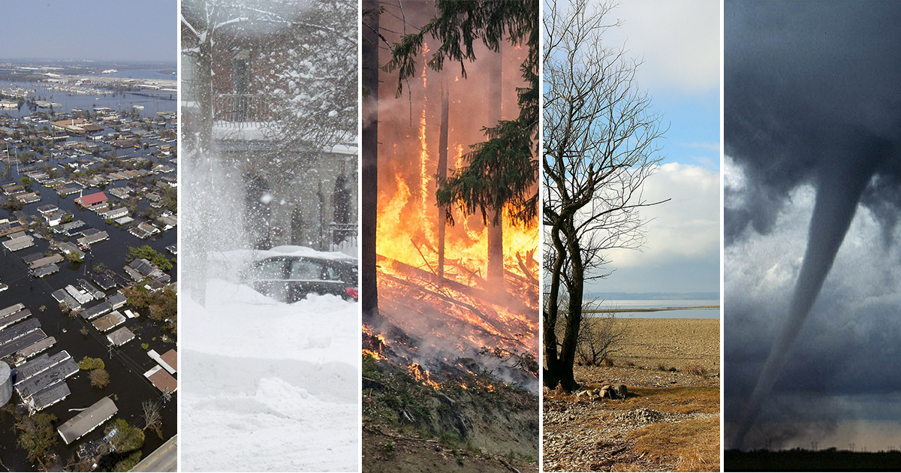
Disaster Damage Assessment Using Semantic Change Detection and Deep Learning: An Automated Framework for Damage Classification
Author: G. Karthika (23NG1A6118), M. Vijaya (23NG1A6139)
Y. Ajay(23NG1A6164), V. Praveen (23NG1A6159)

Slide 2
Abstract
Accurate and timely damage assessment is crucial for effective disaster response and resource allocation.
The project introduces an automated framework using Siamese Neural Networks and YOLOv8
instance segmentation.
Before-and-after satellite/drone imagery is analyzed for structural changes.
Integrated change detection + object recognition enables precise identification of building footprints.
Damage severity is quantified using pixel-level change percentage.
The system generates GIS-compatible damage classification reports.
Provides emergency teams with timely, actionable insights for informed decision-making and
response planning.

Slide 3
Introduction
Rapid and accurate damage assessment is essential for effective emergency response and resource allocation.
Traditional methods (manual surveys, 2D image interpretation) are slow, subjective, and often inconsistent.
Deep learning enables automated, pixel-level damage detection using semantic change detection and
segmentation.
Siamese U-Net detects pixel-level structural changes, while YOLOv8 provides precise building footprints.
The proposed framework integrates both models to classify structures as Minor, Major, or Destroyed.
Generates GIS-compatible reports, reducing assessment time from weeks to minutes and improving
response planning.

Slide 4
IMPLEMENTATION
Overall system architecture :
The framework is a unified multi-stage pipeline for automated disaster damage assessment.
Processes satellite and drone imagery using deep learning models.
Workflow includes: data collection → preprocessing → semantic change detection → object
segmentation → GIS-compatible classification.
Each module works collaboratively to ensure smooth end-to-end analysis.
Supports multiple disaster types: earthquakes, floods, cyclones, building
collapses, etc.
Ensure rapid, scalable, and accurate damage assessment.
Designed for real-world emergency response and decision-making.

Slide 5
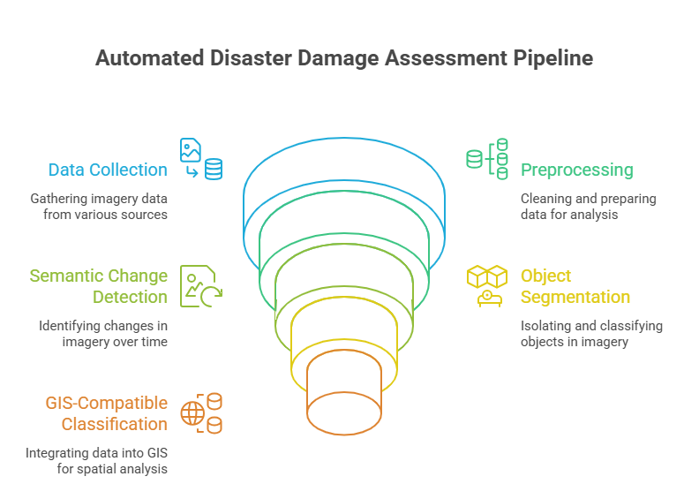

Slide 6
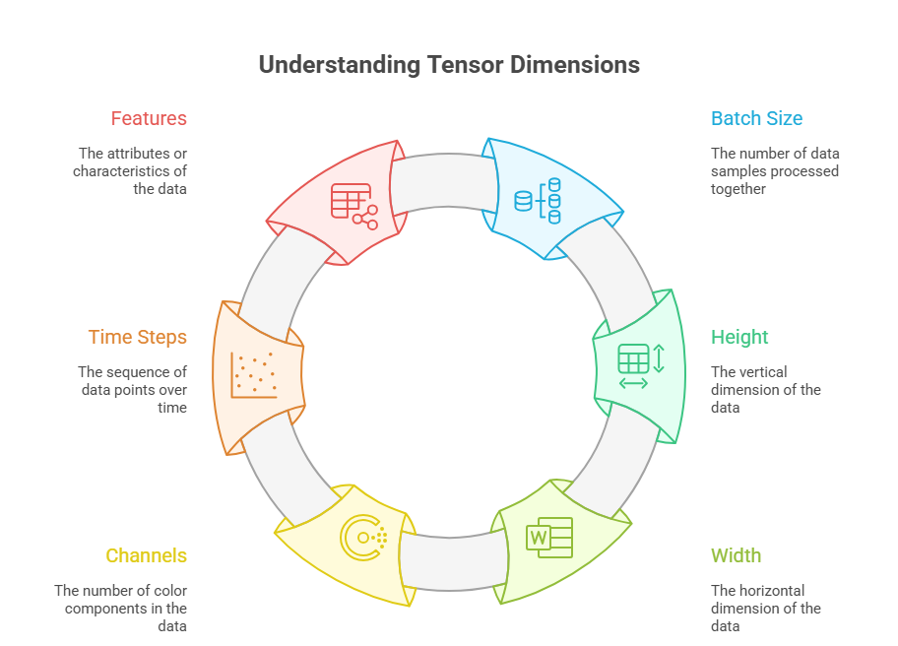
1. Data Sources and Acquisition
Satellite data: Copernicus EMS, Sentinel-2, Planet Labs
(10 m–submeter).
Automated pre/post-disaster image retrieval.
Drone data: DJI Phantom 4 RTK with high-overlap flights.
Benchmark datasets: xBD, xView2, Copernicus EMS.
2. Preprocessing Workflow
Before feeding the images into the models, the system performs standard preprocessing operations:
• Resizing image pairs to a fixed resolution (512×512).
• Normalizing pixel values using mean and standard deviation vectors.
• Aligning pre- and post-disaster images to ensure spatial consistency. This preprocessing ensures that the Siamese U-Net receives properly formatted tensors for change detection. .

Slide 7
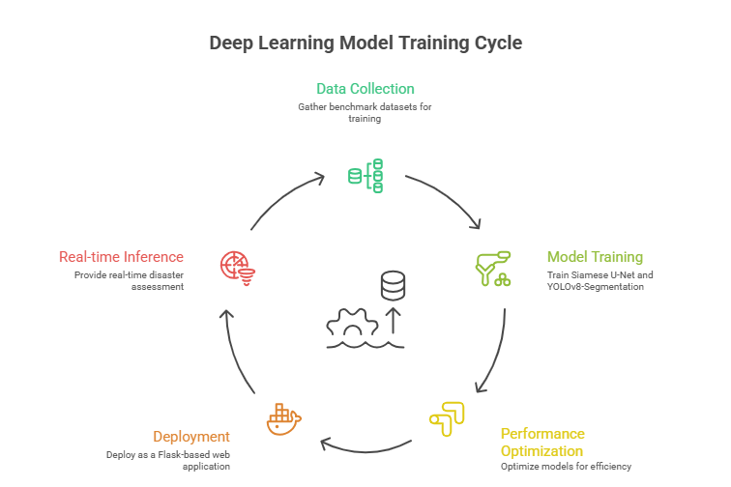
4. Deep Learning Model Training
Modified U-Net with ResNet-50 encoder; input is
stacked pre/post RGB (512×512×6).
Losses: weighted cross-entropy + Dice; optimizer:
Adam with LR scheduler.
Augmentations: rotation, scaling, brightness shifts,
cutout masks.
Trained for up to 100 epochs on NVIDIA V100 with
early stopping.
Uses transfer learning from ImageNet + xView2,
multi-scale inputs, cyclical learning rates.

Slide 8
Damage Severity Classification :
The system calculates damage severity using the Intersection over Area (IoA) method:
• Changed pixels (from Siamese U-Net) are intersected with building masks (from YOLOv8).
• The ratio of changed pixels to total building pixels gives the damage percentage.
• Classification thresholds: o Destroyed: > 70% o Major: 25–70% o Minor: 5–25% o Safe: ≤ 5%
This classification is displayed visually with color-coded bounding boxes
(Green = Safe, Orange = Major, Red = Destroyed) and summarized in a GIS-compatible
report panel.
Tools and Technologies Used :
• Python 3.8
• PyTorch for Siamese U-Net training and inference
• Ultralytics YOLOv8 for building segmentation
• OpenCV, NumPy for image preprocessing and visualization
• Flask for web deployment and interactive analysis
• GDAL, Rasterio, GeoPandas for GIS compatibility and spatial data handling

Slide 9
RESULT
The system performs post-disaster semantic change detection and building-level damage classification.
Siamese U-Net identifies change regions between pre- and post-disaster images.
YOLOv8 Segmentation extracts building footprints for object-level analysis.
Damage is classified into four severity levels:
Destroyed
Major
Minor
Safe
Final output includes a GIS-compatible visual assessment with:
Red change-detection overlays showing affected areas
Color-coded bounding boxes around buildings
Damage labels for each structure
Summary panel showing total buildings + count per damage category
The categorical output enables fast interpretation, aiding time-critical disaster response teams.

Slide 10
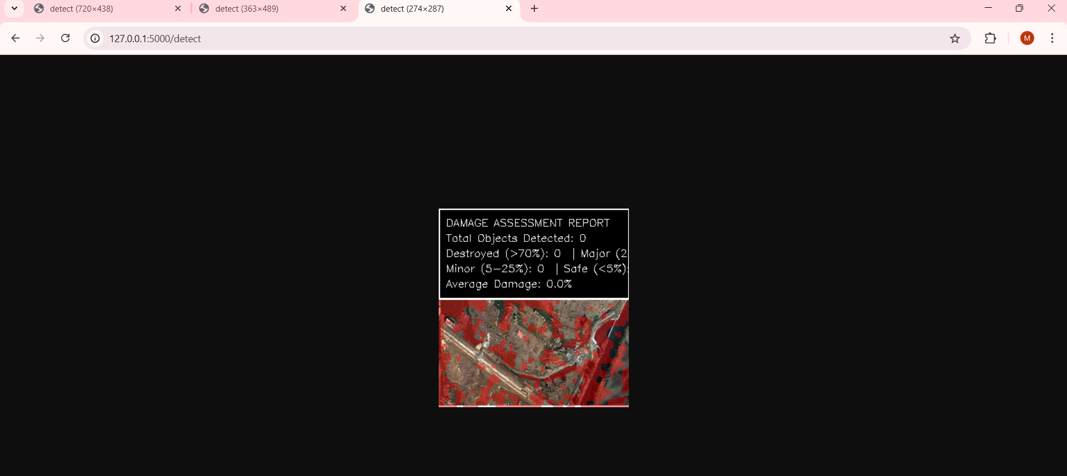
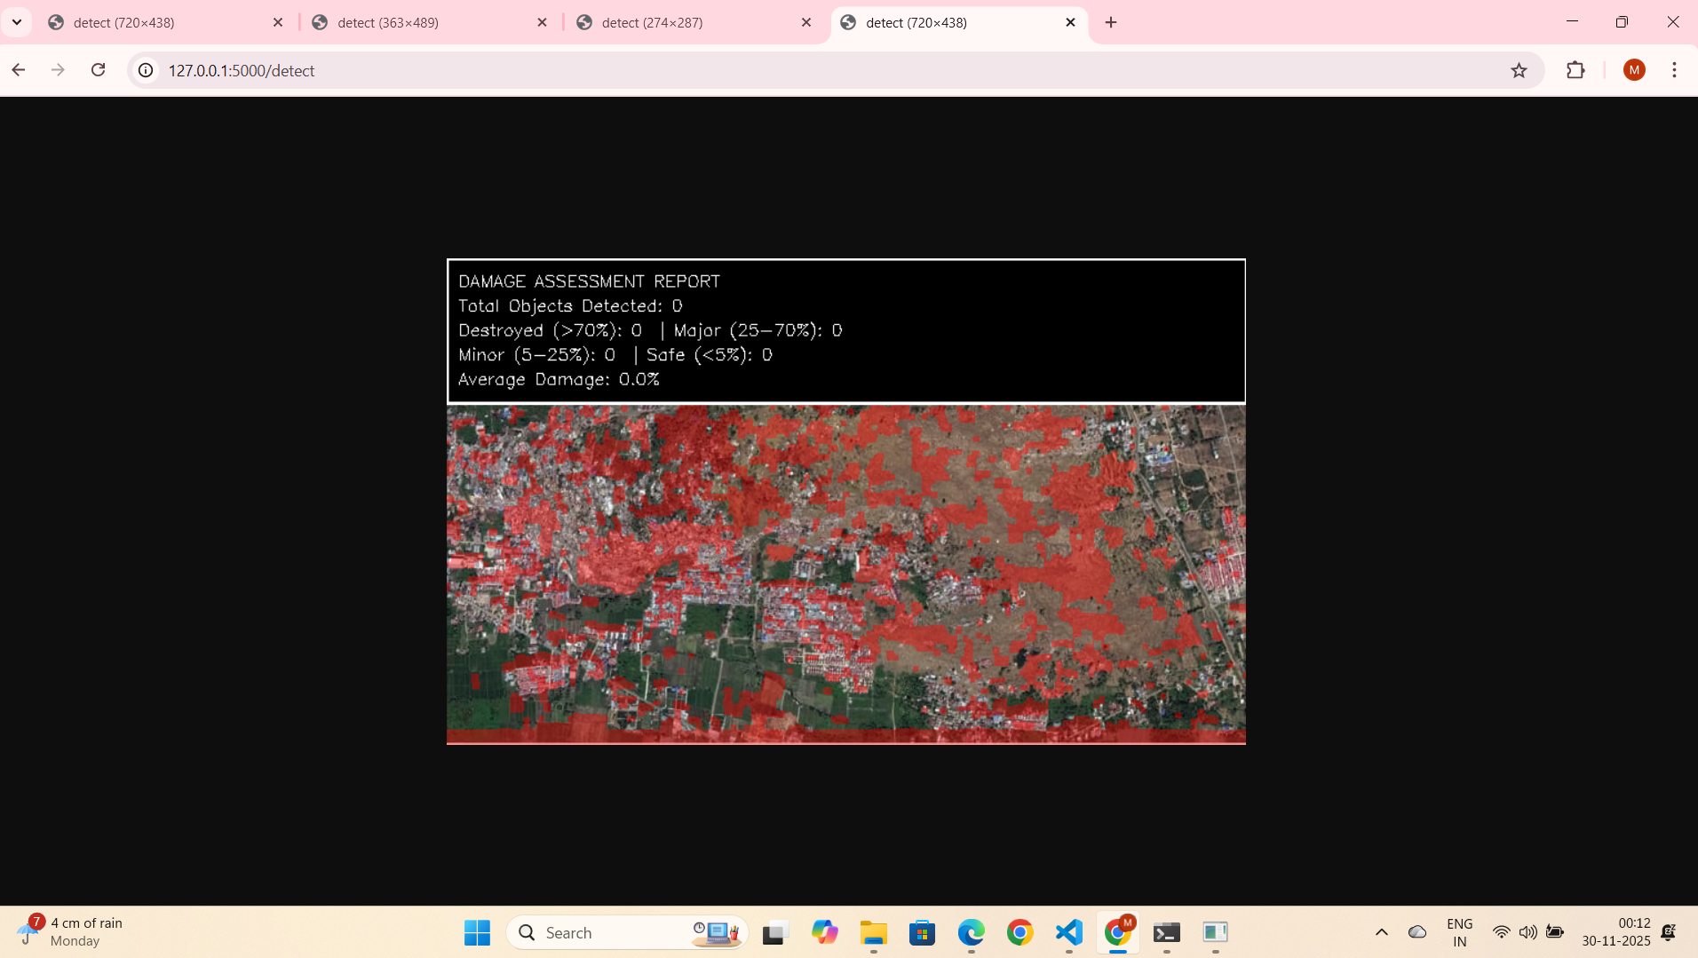
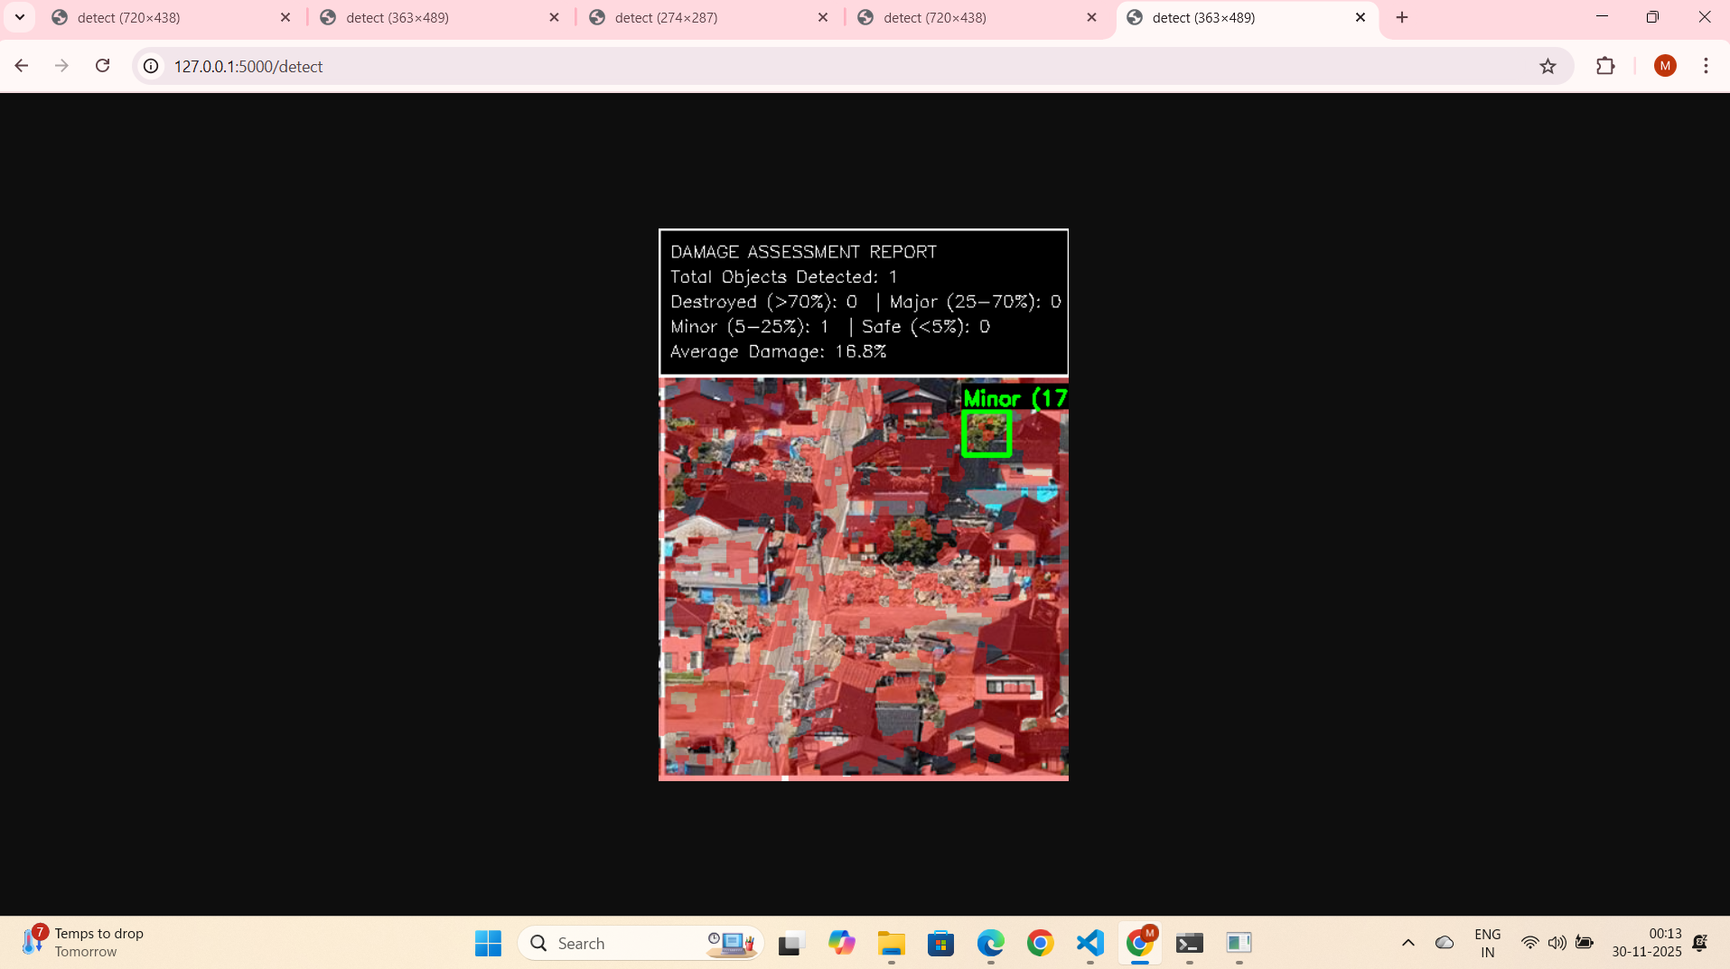

Slide 11
CONCLUSION
The original plan included detailed damage percentage visuals and 3D debris estimation.
The final system focuses solely on categorical damage levels (Destroyed, Major, Minor, Safe).
This simplification improves clarity and speeds up decision-making for emergency responders.
The system still calculates exact damage percentages internally using the IoA method.
These percentages appear in the summary statistics to maintain quantitative accuracy.
Excluding volumetric/3D analysis makes the workflow faster, more stable, and practical.
The final output remains fully GIS-compatible, linking each building’s location, category, and
percentage.

Slide 12
FUTURE SCOPE
Integrate damage-percentage values directly into bounding-box labels.
Adopt transformer-based models (SegFormer, Swin-UNet) for improved segmentation.
Use geospatial foundation models like Prithvi and SatMAE for better cross-region generalization.
Incorporate SAR datasets (Sentinel-1) for reliable assessment during cloud, smoke, or nighttime.
Explore LiDAR or lightweight 3D reconstruction for volumetric debris estimation.
Enable edge deployment on devices like NVIDIA Jetson for real-time field analysis.
Build automated GIS reporting pipelines and link outputs with hazard–vulnerability models for predictive
insights.

